Slide 1
Quantum Computing overhype & opportunities
Nicolas Renaud

Slide 2
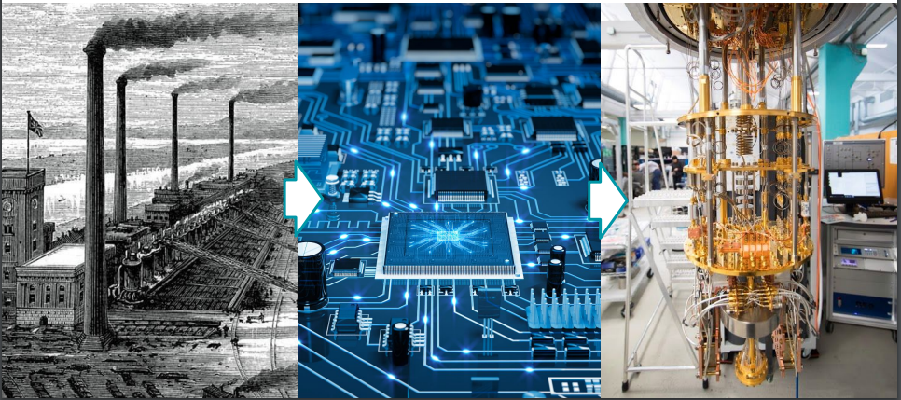

Slide 3
What happens when ‘if’ turns to ‘when’ in quantum computing

Slide 4
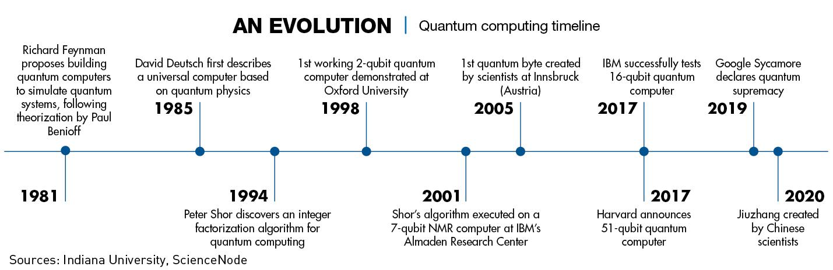
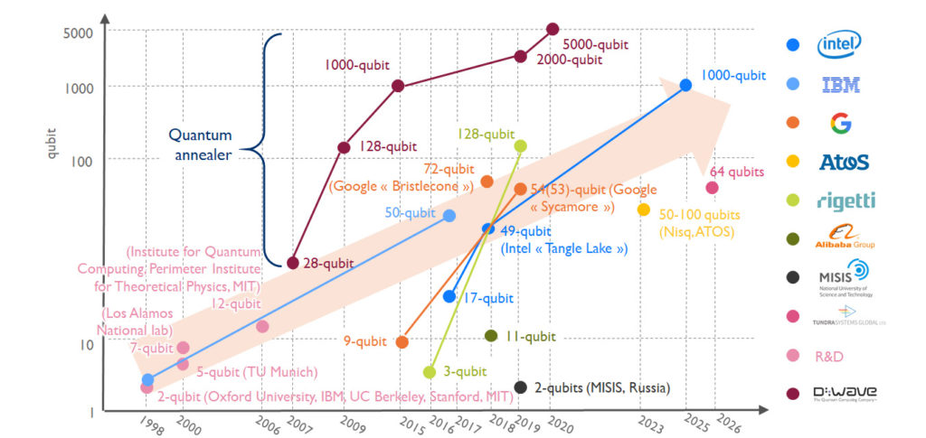
1K+-qubits
433-qubits
126-qubit

Slide 5
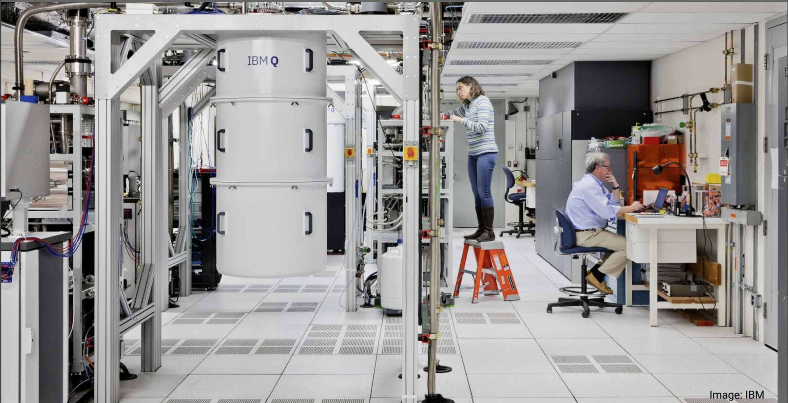

Slide 6
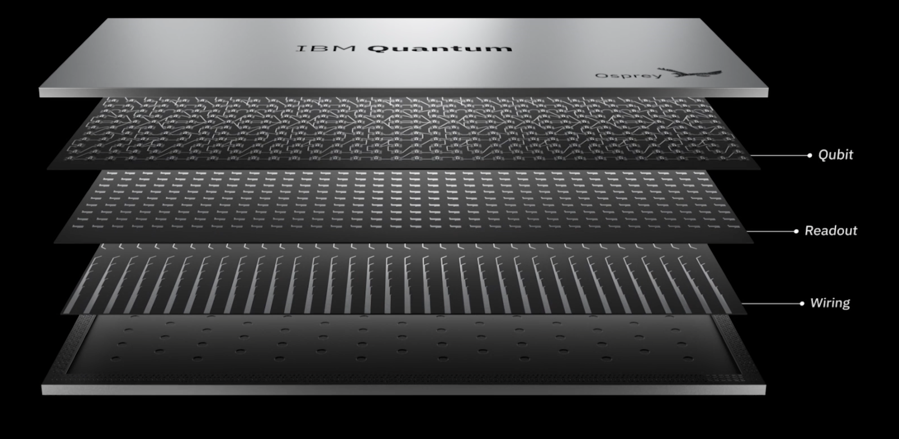

Slide 7
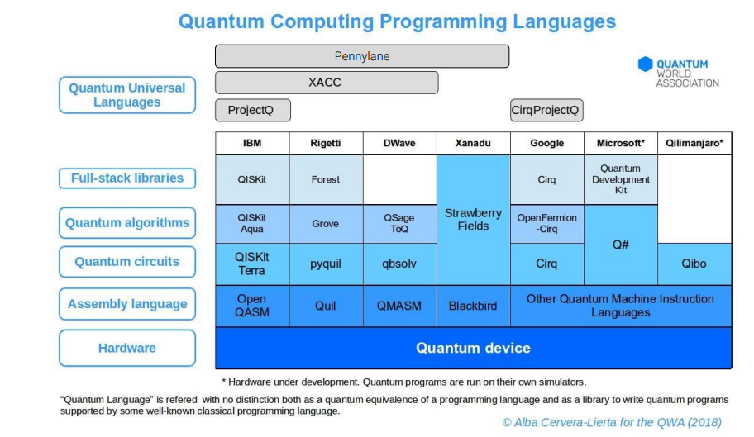

Slide 8
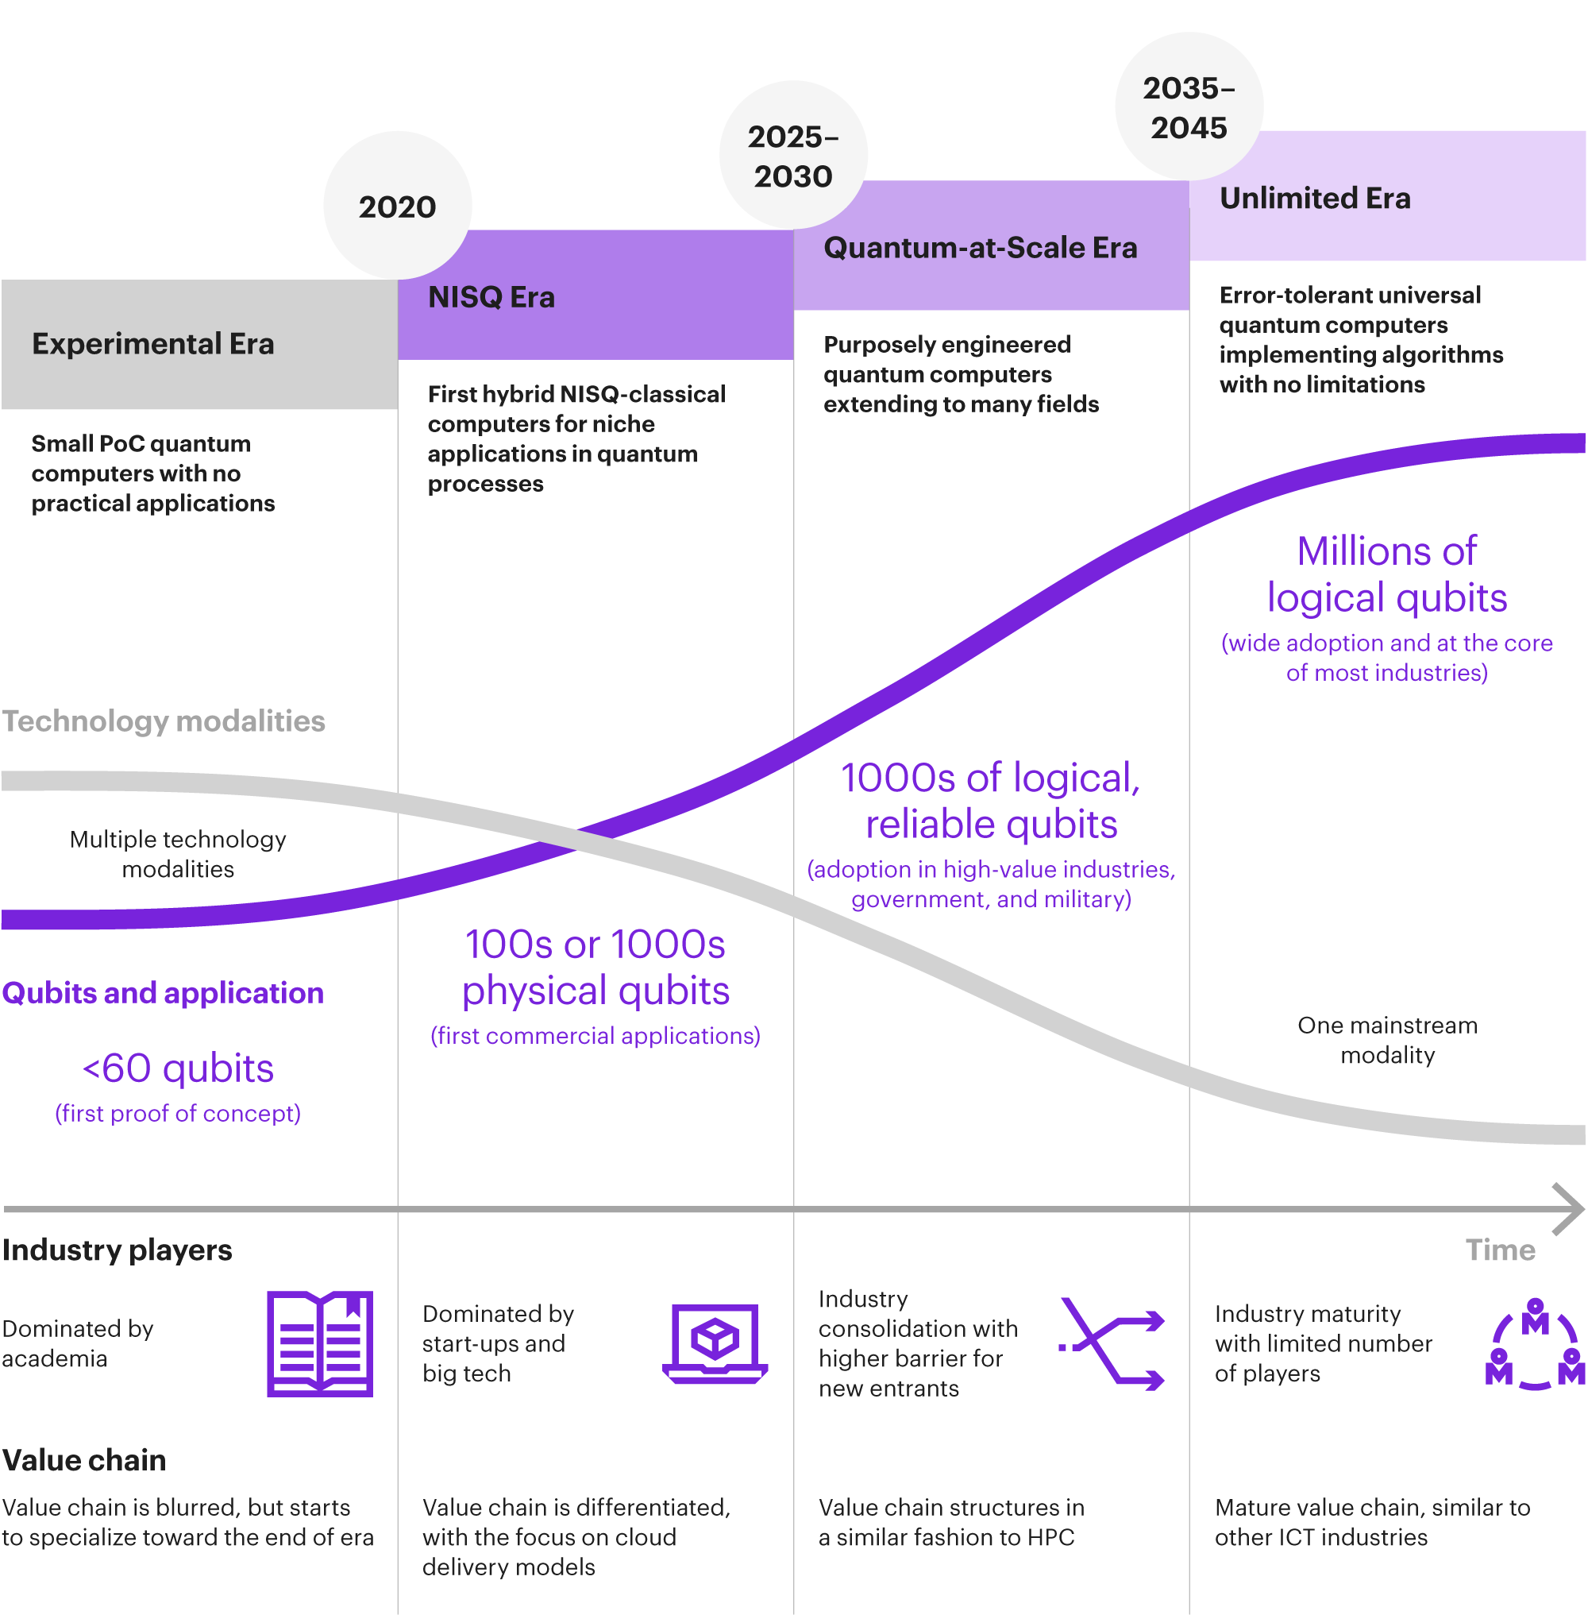

Slide 9
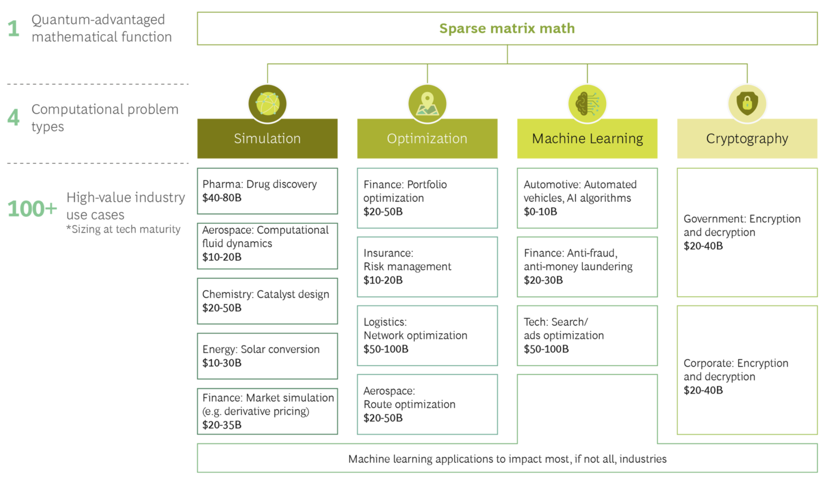

Slide 10
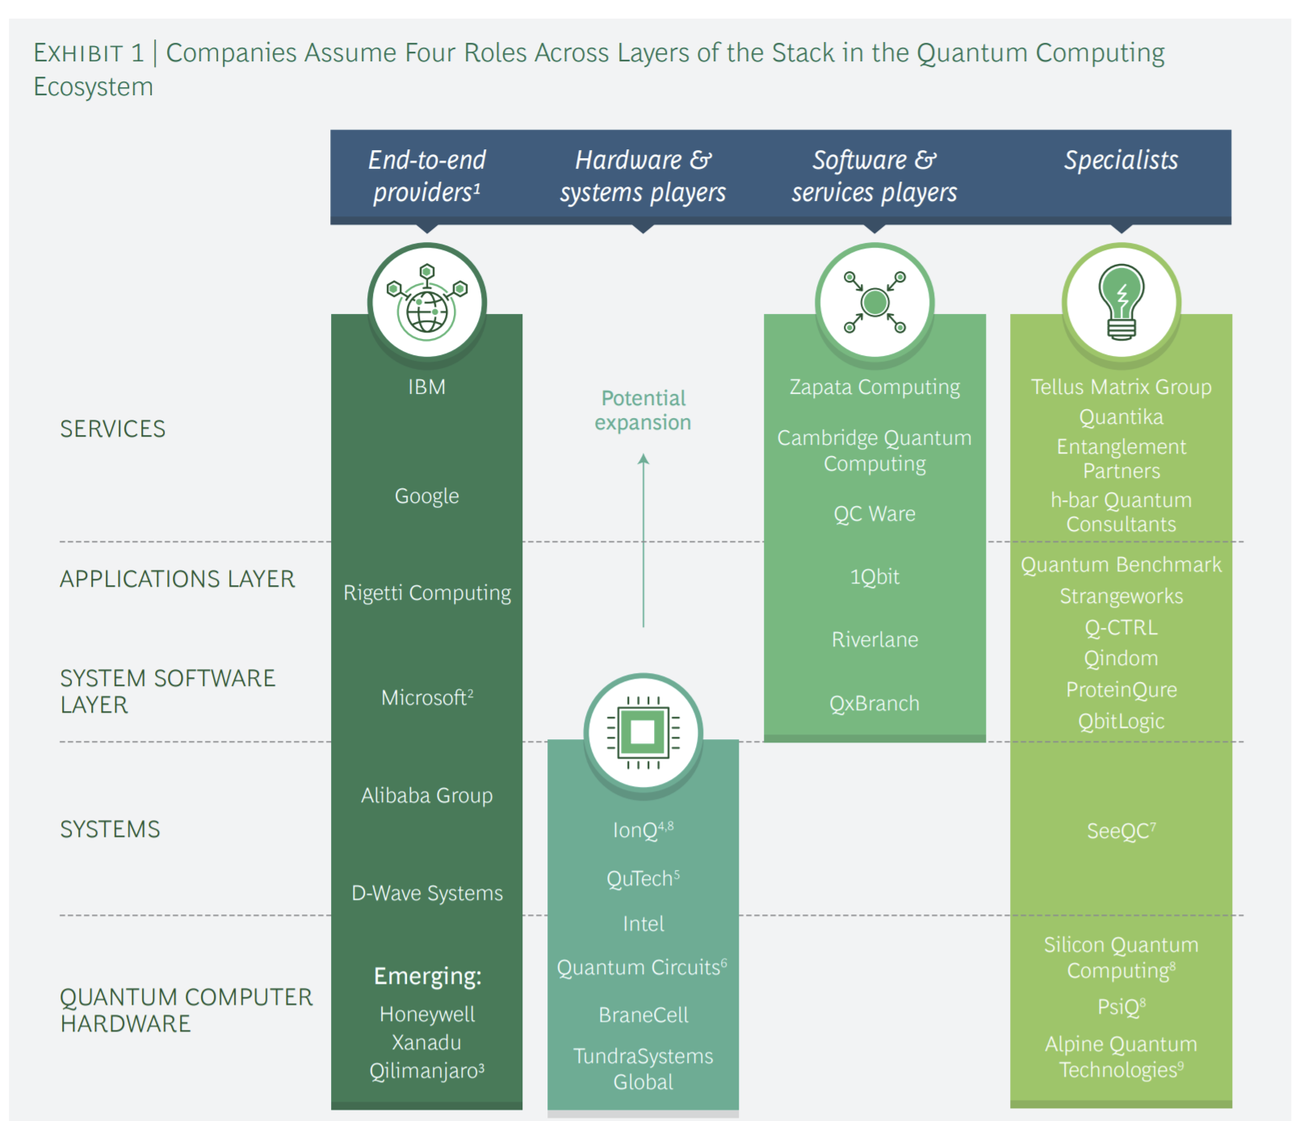
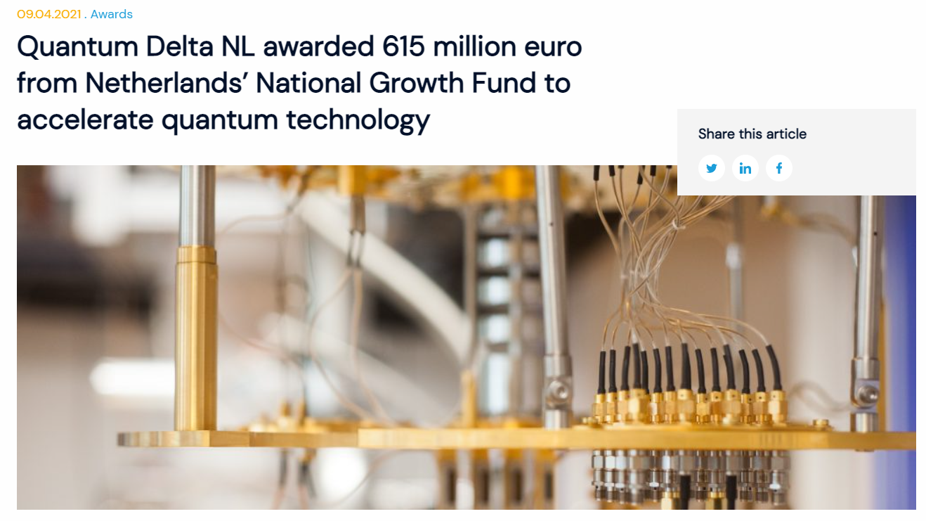

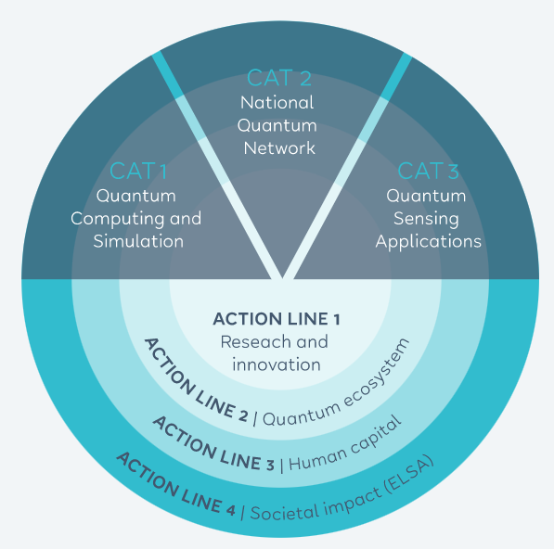

Slide 11
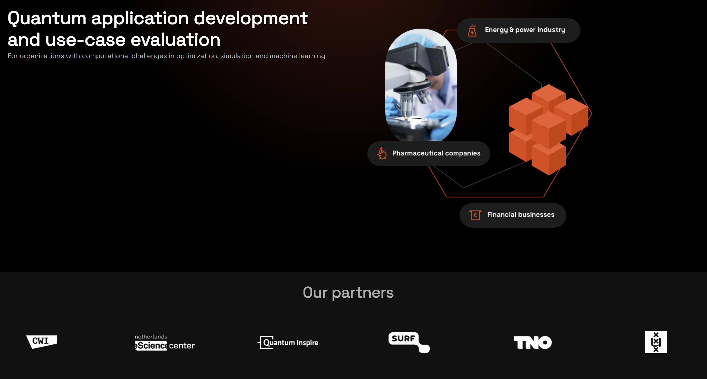




Quantum Application Lab
info@quantumapplicationlab.com
quantumapplicationlab.com
Amsterdam Science Park
The Netherlands

Slide 12
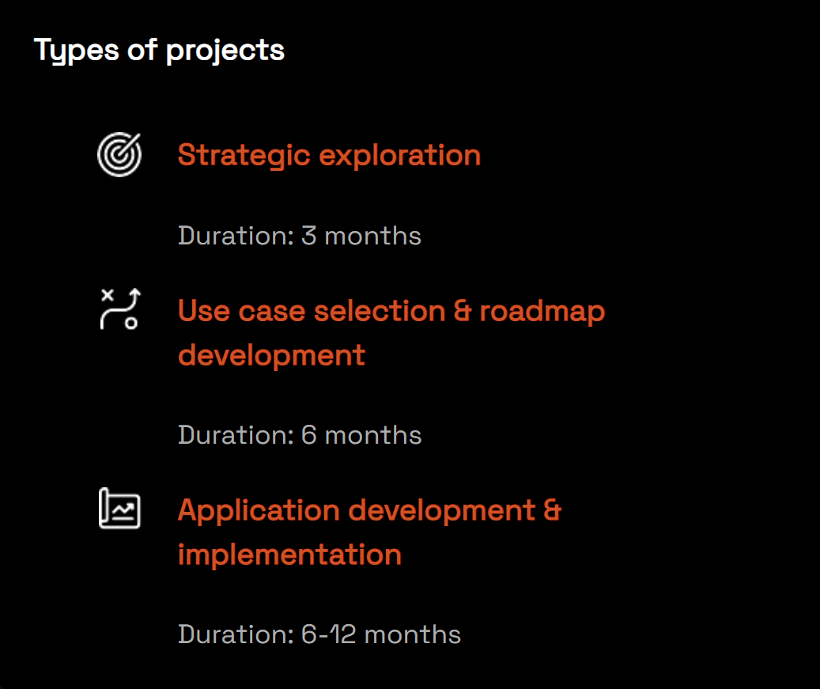






Hardware provider
Business Application
Algorithm Development
High Performance Computing
Research Software Development
Application Development

Slide 13

















Medical Application
Radioastronomy
High Energy Physics
Chemistry / Material Science
Academic
Energy Supplier
Industrial
Microelectronics
Food Industry
Finance
Airline companies
Telemetry

Slide 14
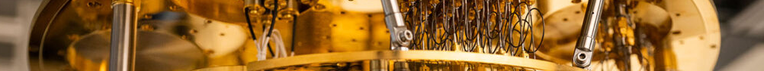


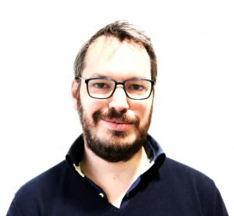


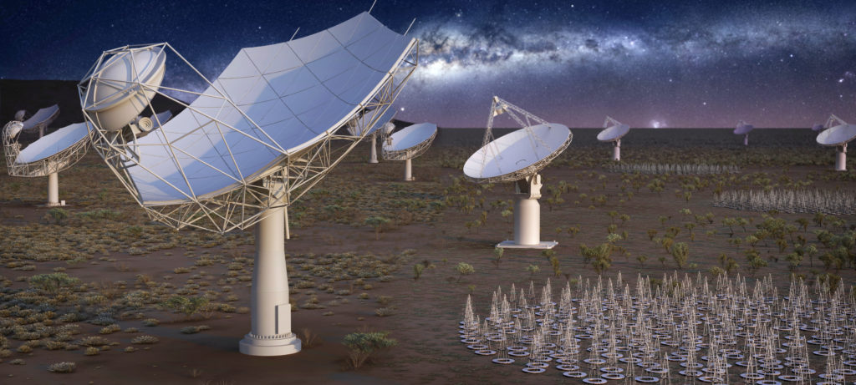
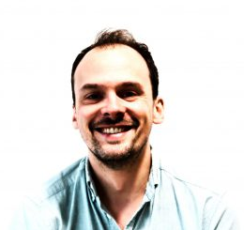
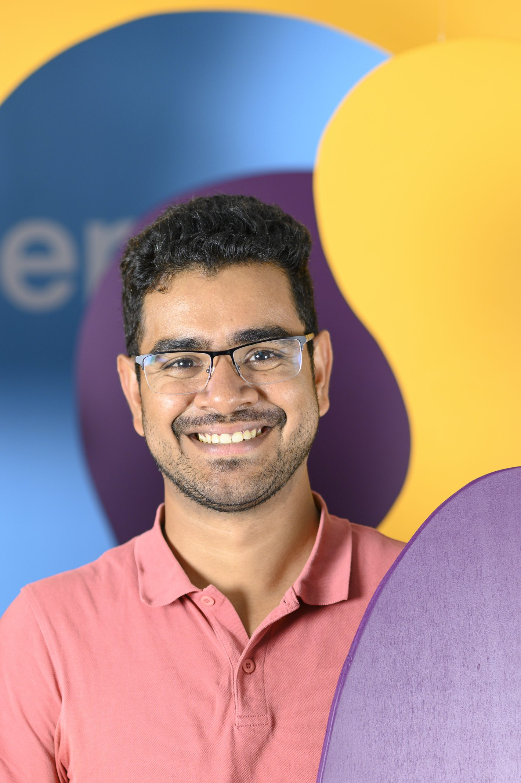

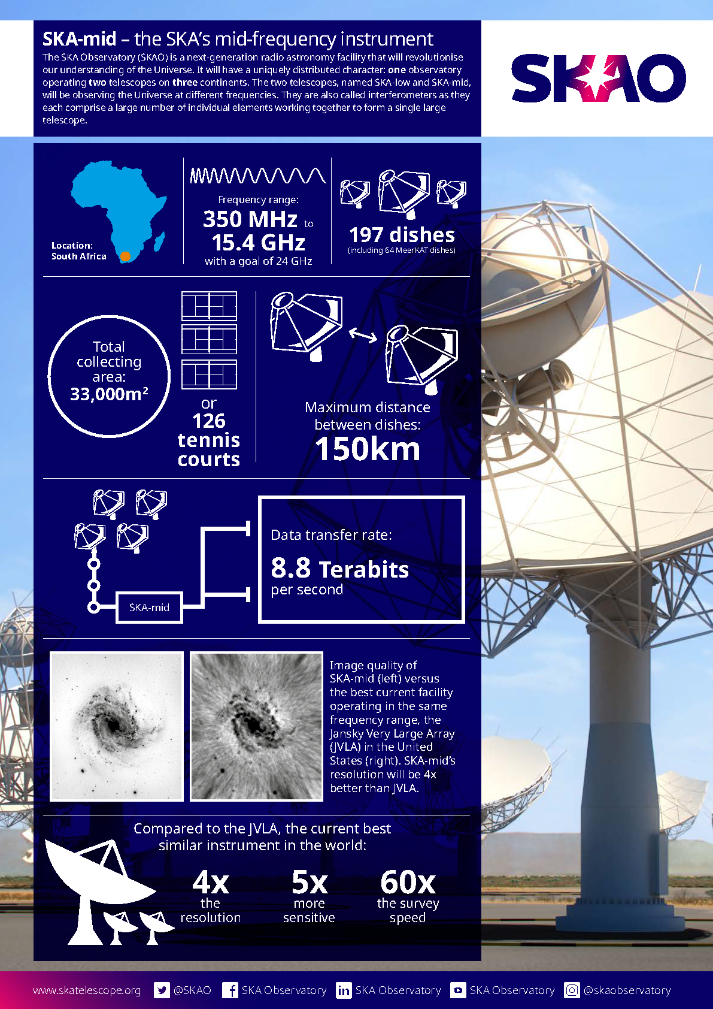
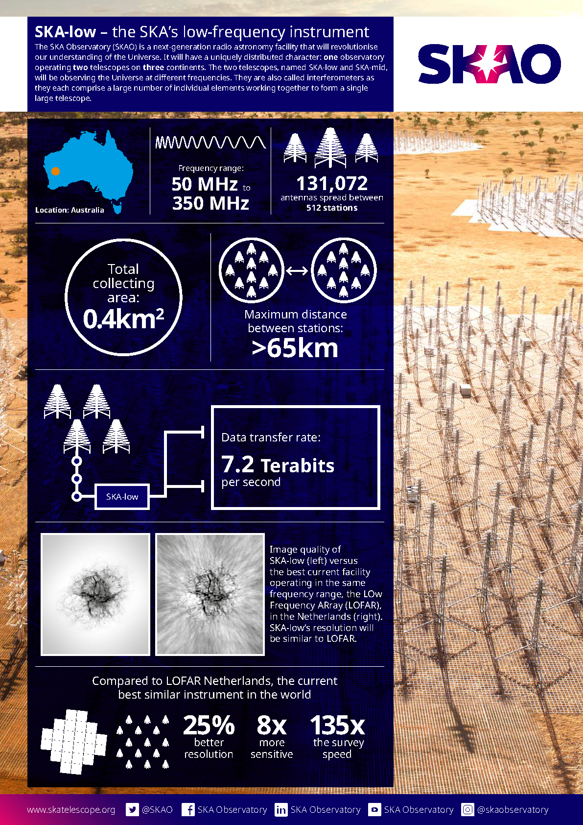
Integrating Quantum Computers in Radio-Telescopes
Chris Broekema

Slide 15
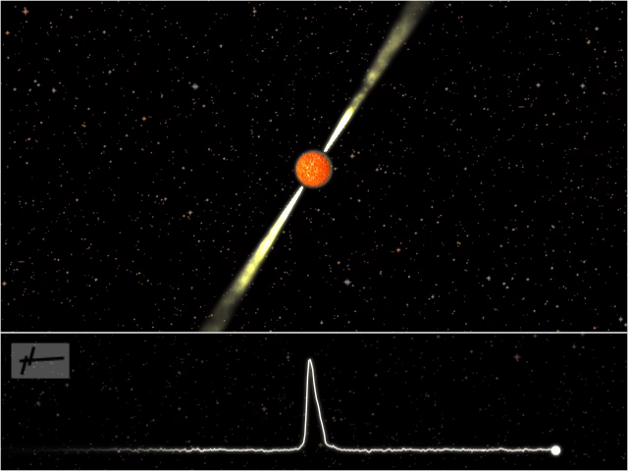
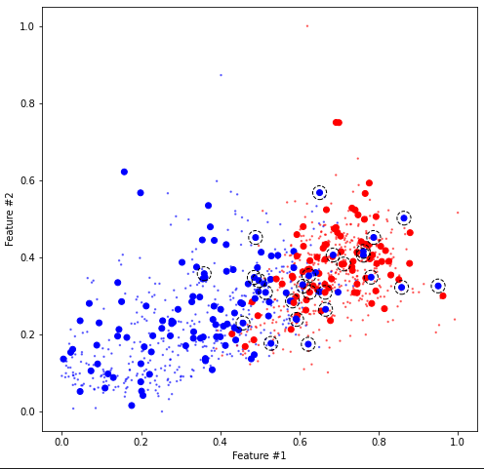
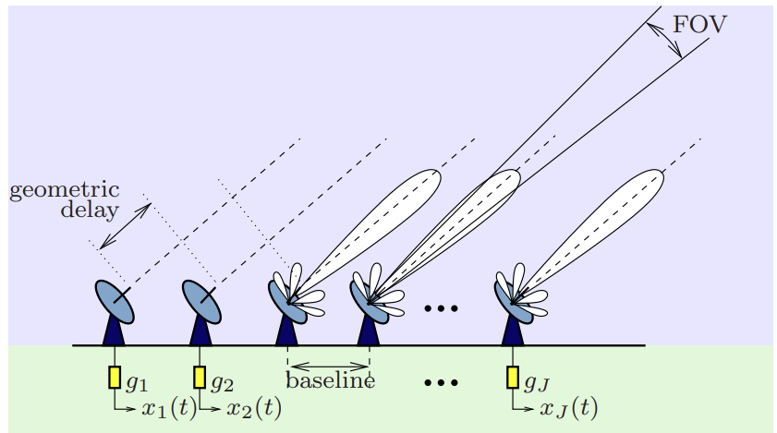
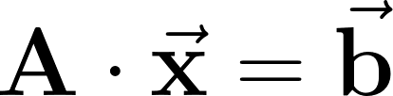
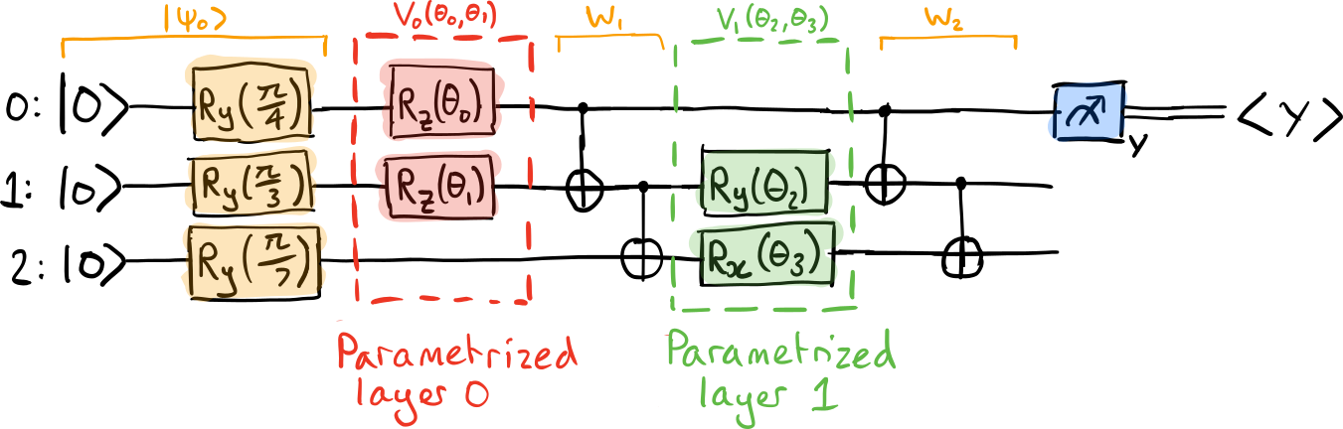
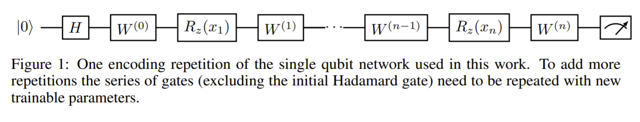
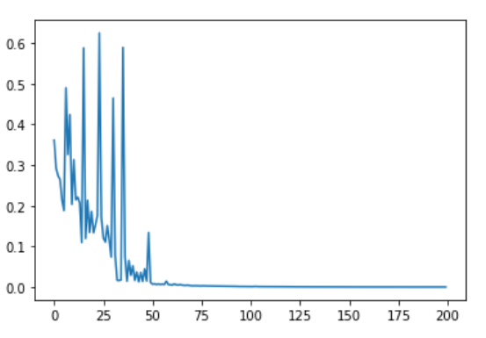
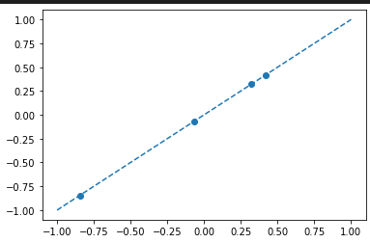
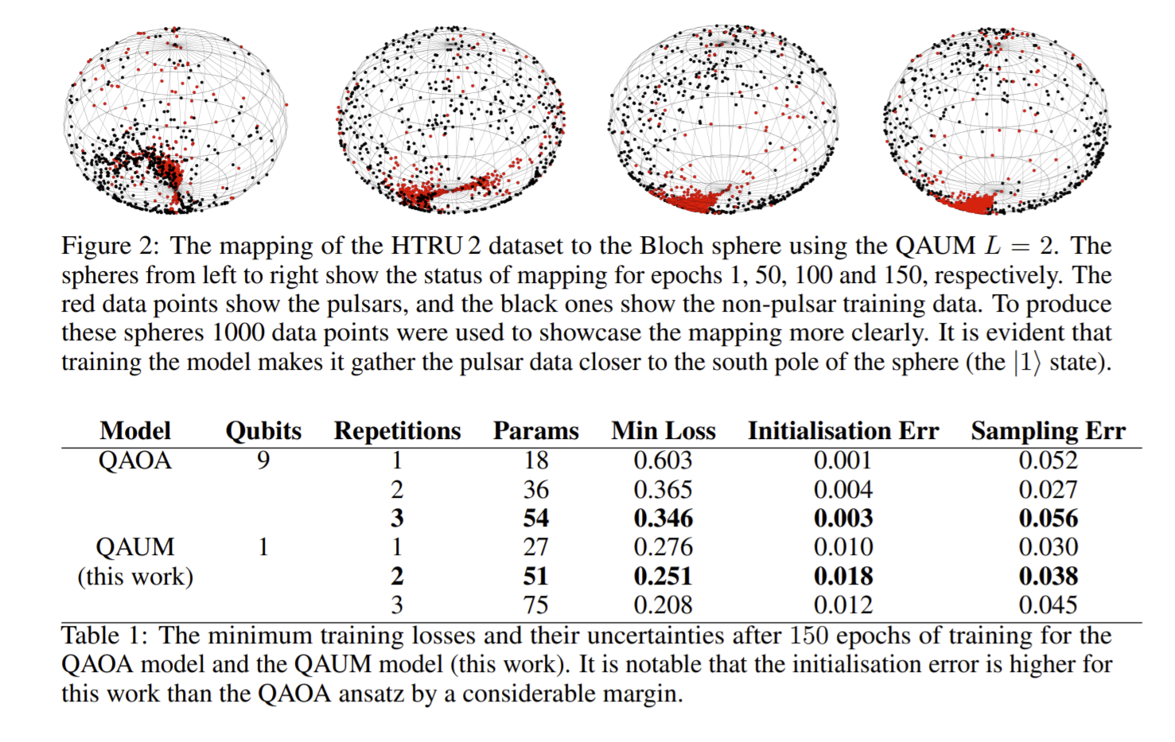
Linear System
8 features
1000 points
89% Accuracy
Calibration Challenges for the Next Generation of Radio Telescopes
Stefan Wijnholds et al ASTRON 2018
Quantum Machine Learning for Radio Astronomy
https://arxiv.org/pdf/2112.02655.pdf

Slide 16
Medical Application
Radioastronomy
High Energy Physics
Chemistry / Material Science
Academic
Energy Supplier
Industrial
Microelectronics
Food Industry
Finance
Airline companies
Telemetry

Slide 17


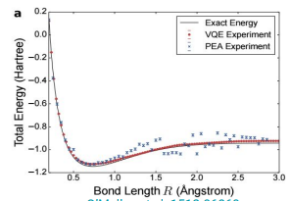
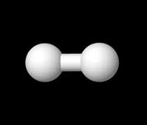
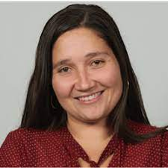
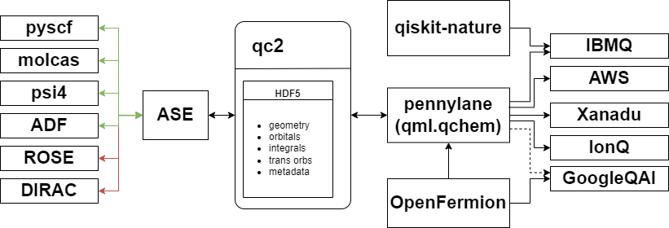
Bridging Quantum Chemistry and Quantum Computing
Luuk Visscher
Ariana Torres
Carlos Rocha
Nicolas Renaud

Slide 18
Medical Application
Radioastronomy
High Energy Physics
Chemistry / Material Science
Academic
Energy Supplier
Industrial
Microelectronics
Food Industry
Finance
Airline companies
Telemetry

Slide 19

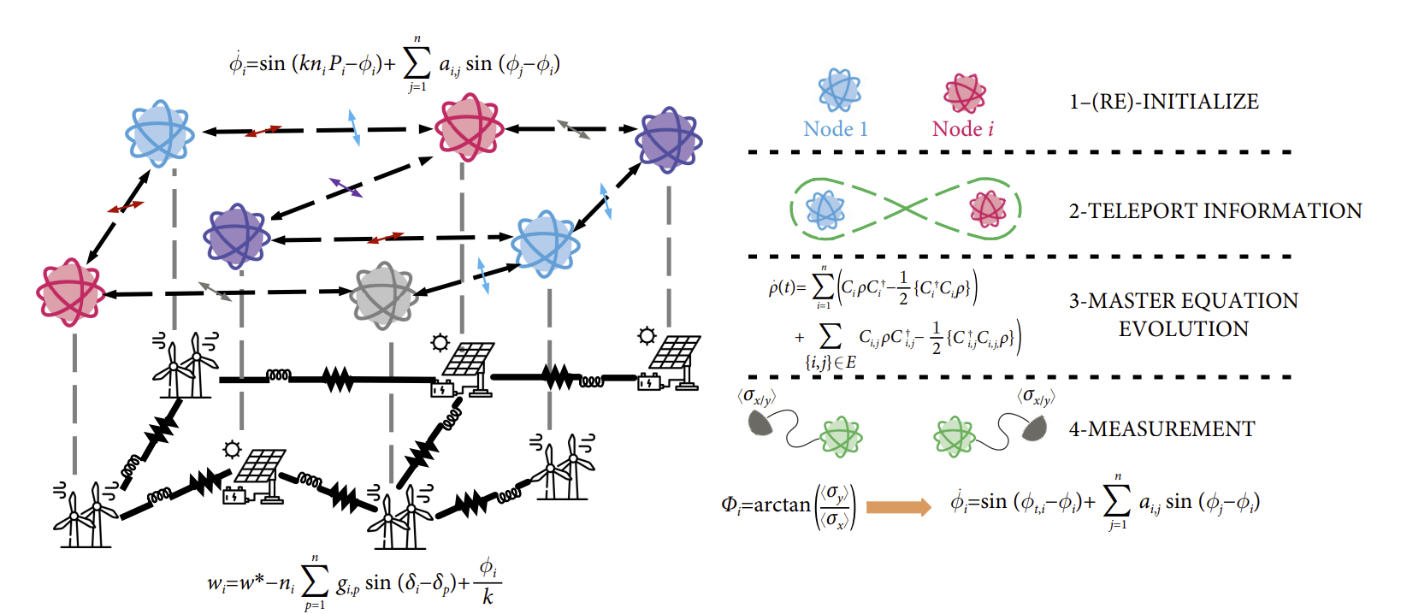
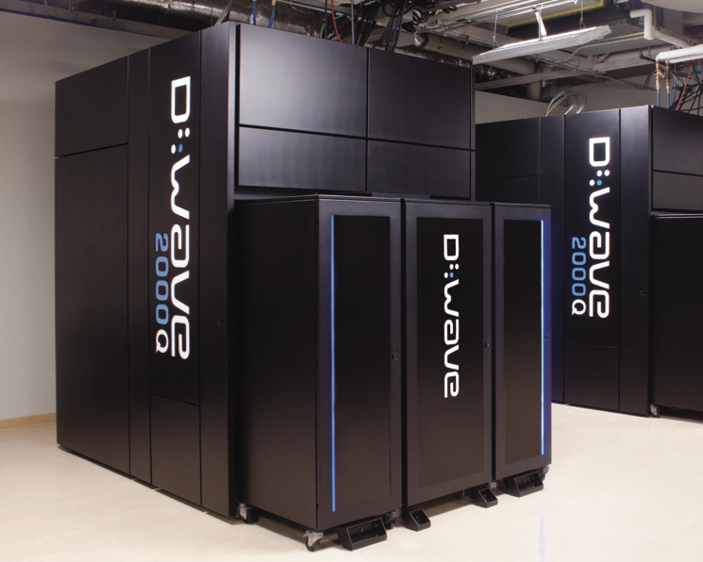
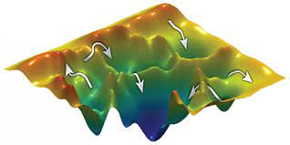
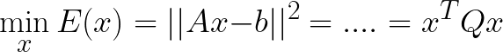
Modelling the Power Grid Using QC

Slide 20
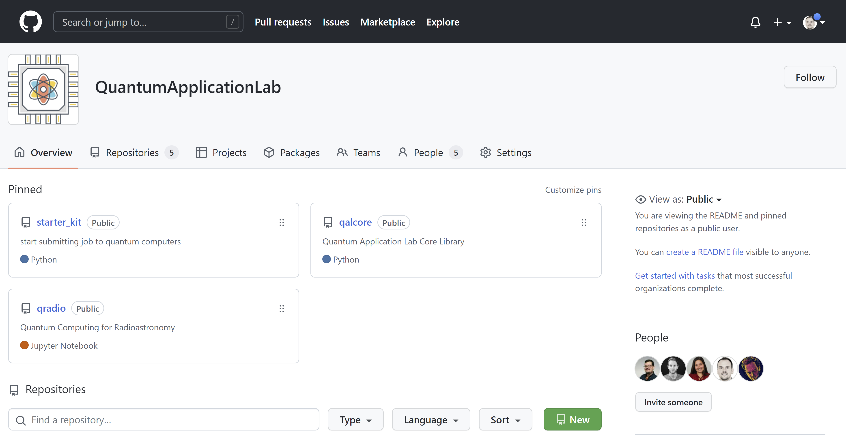
https://github.com/QuantumApplicationLab

Slide 21
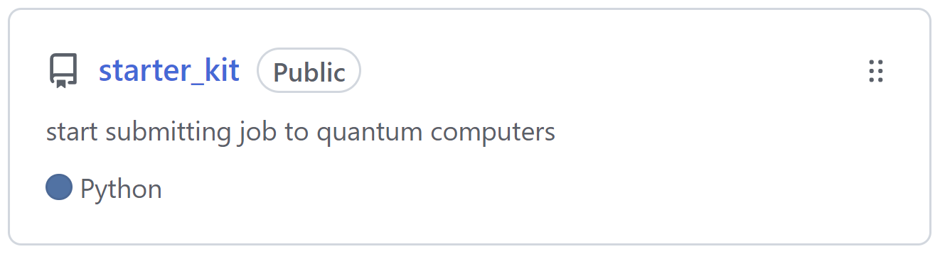

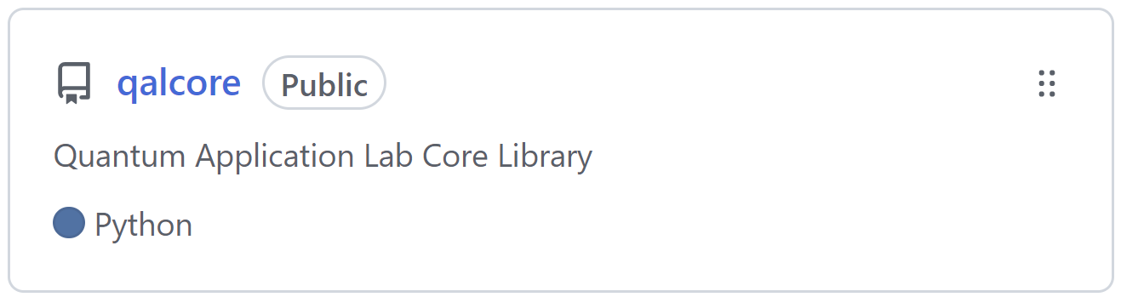
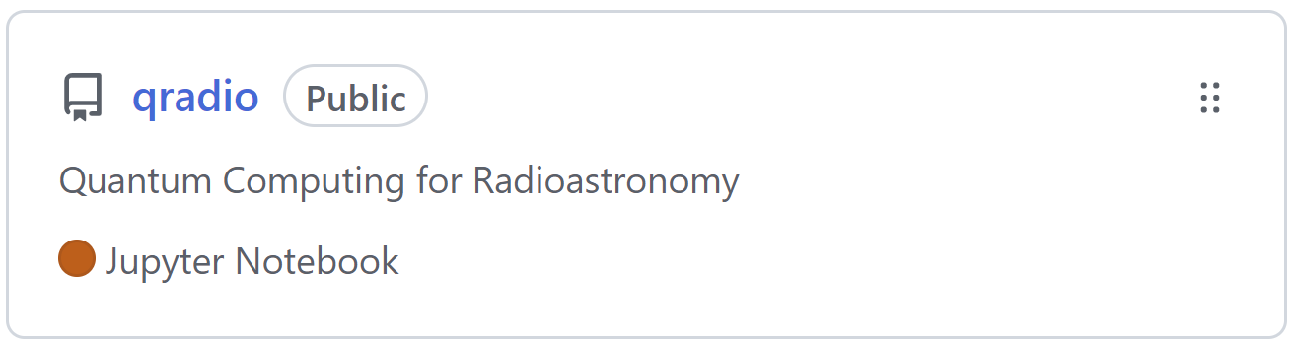
Example programs to submit jobs to different providers
Generic algorithm for reuse within/outside of QAL
Software for specific QAL projects

Slide 22
Live Demo ?

Slide 23
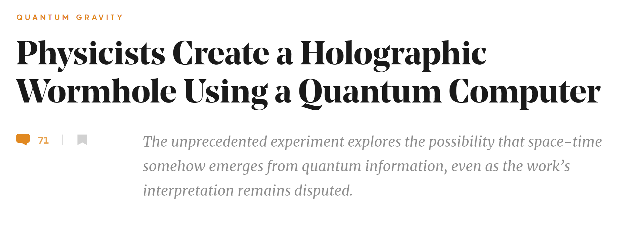
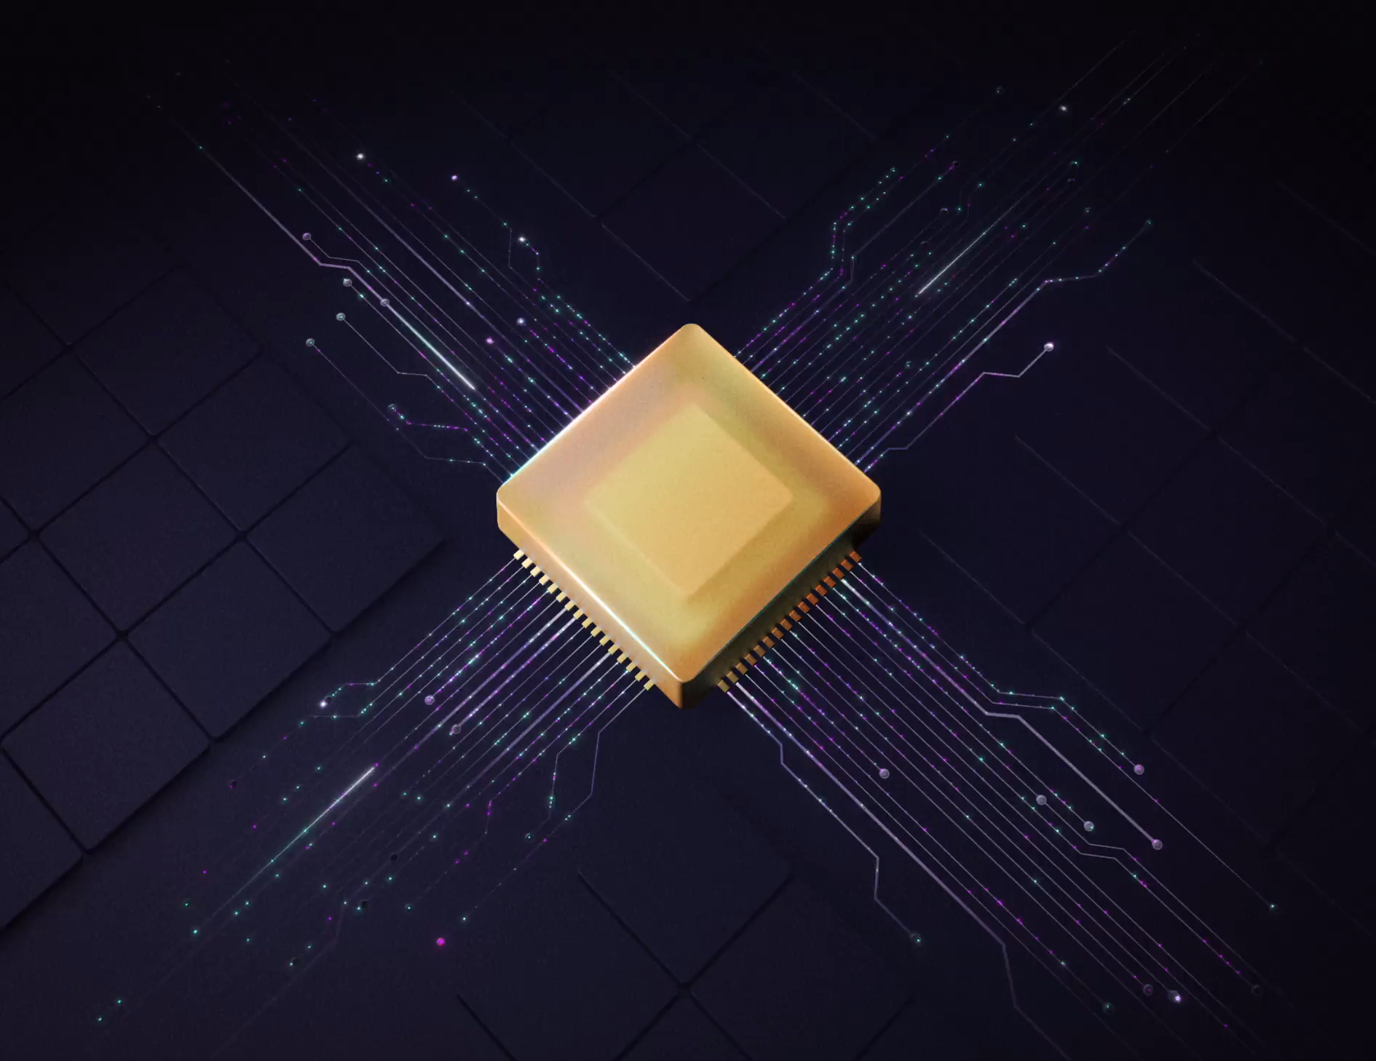
Beware of the
hype nonsense

